Slide 1


AT&T Spam Detector
Deep Learning

Slide 2
Context
Tasks
Problem: Car rental cancellation on Getaround platform
Analyze the effect of a rental delay buffer on both checkin methods
Produce a web dashboard to assist the decision (scope, minimum delay)
Reason: Late car returns cause friction if next user has to wait
Train car pricing optimization models
Proposition: Introduce a buffer delay between consecutive rentals
Provide access to these models through an API endpoint
Also need a car pricing model available through an API
Include the car rental pricing functionality in the web dashboard

Slide 3












Pipeline architecture
Delay analysis data
Dashboard
API
EDA
Tracking server
Servers deployment on
Training
Pricing data

Slide 4
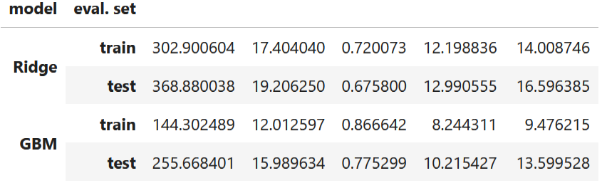

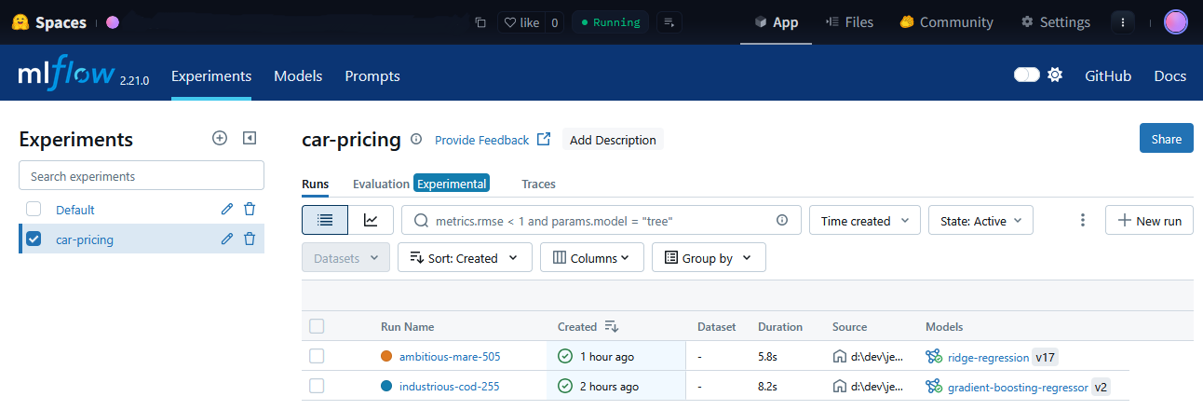
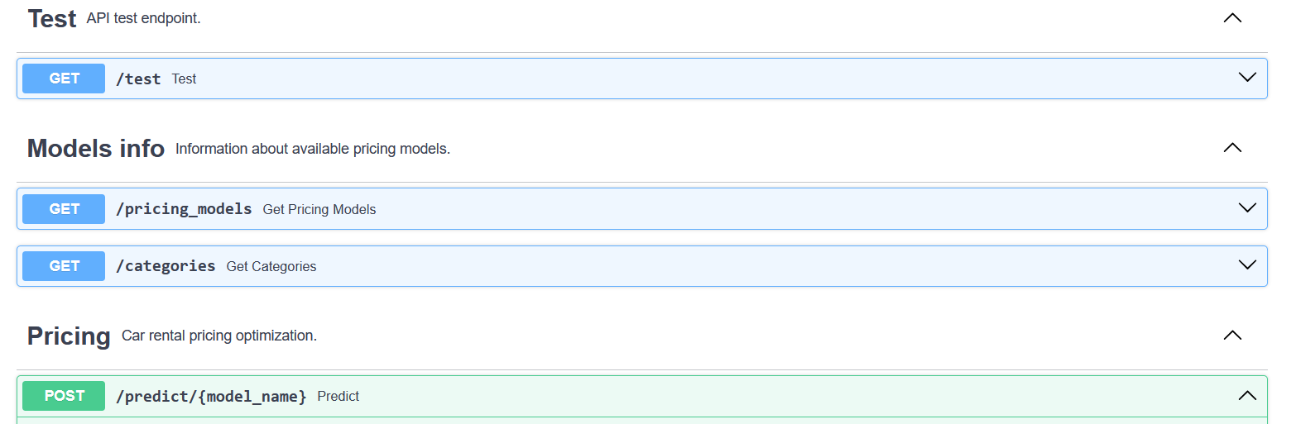
Pricing optimization API
Two pricing models
Ridge regression (Ridge)
Gradient boosting model (GBM)
Model training and tracking
Setup pricing API
Dispatch training on AWS EC2 instances
(MLflow project)
Registered models prediction endpoint
Provides additional model information
Track and record models in Mlflow server

Slide 5
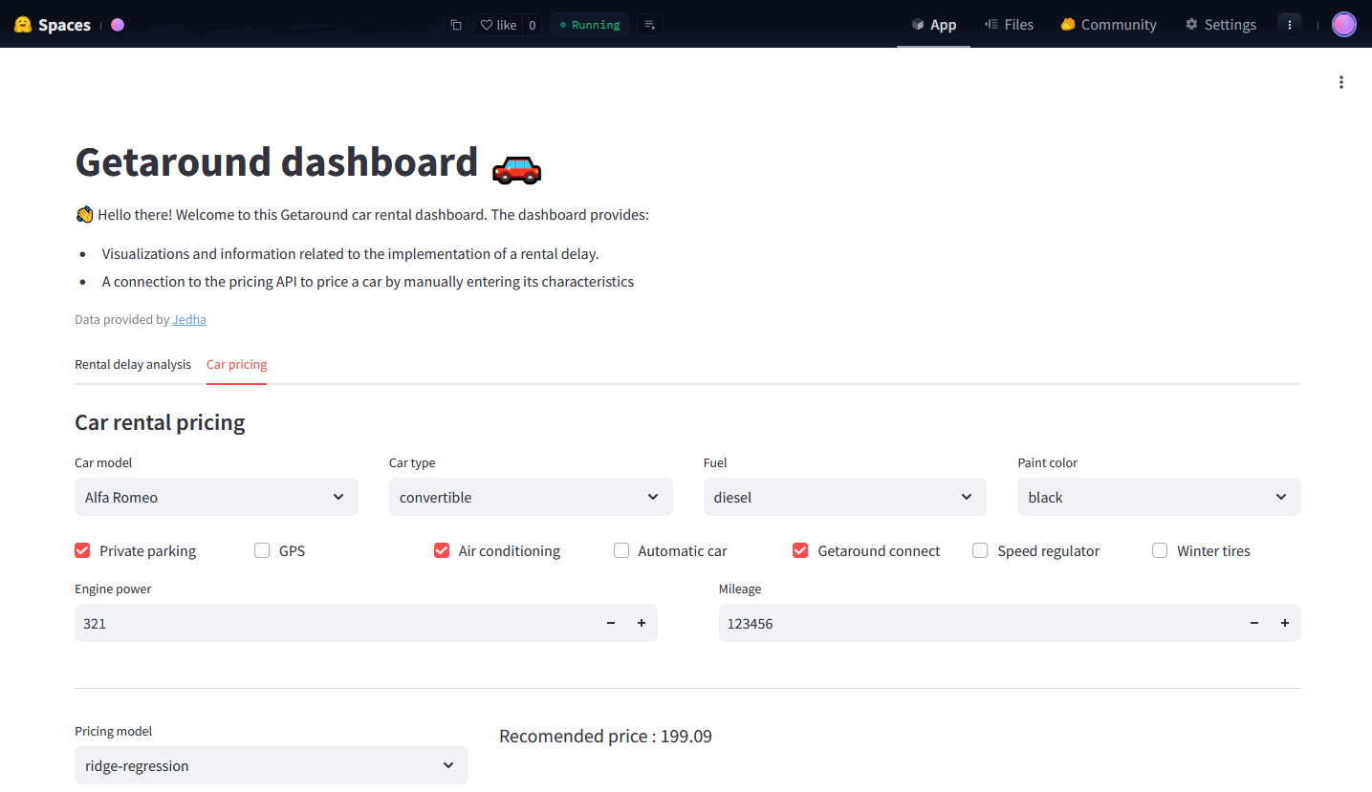
Dashboard : car rental pricing
Check API availability at startup
Fetch models info
Pricing evaluation from user input
(/predict endpoint)

Slide 6
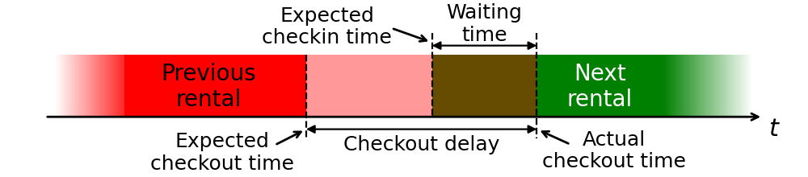
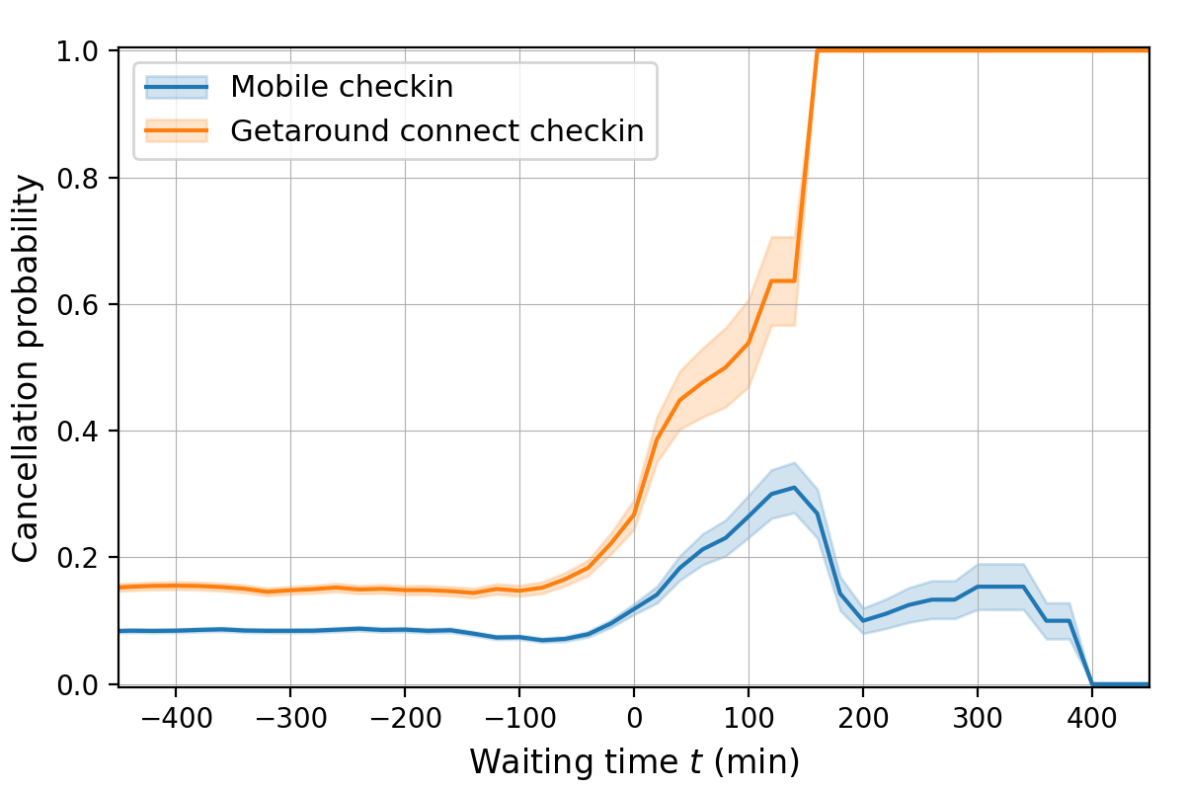
Rental delay analysis
Data visualization
Direct download from AWS S3
Download file locally (61Mb)
Cancel. Prob. Increases with waiting time
Ridge regression (Ridge)
Gradient boosting model (GBM)

Slide 7
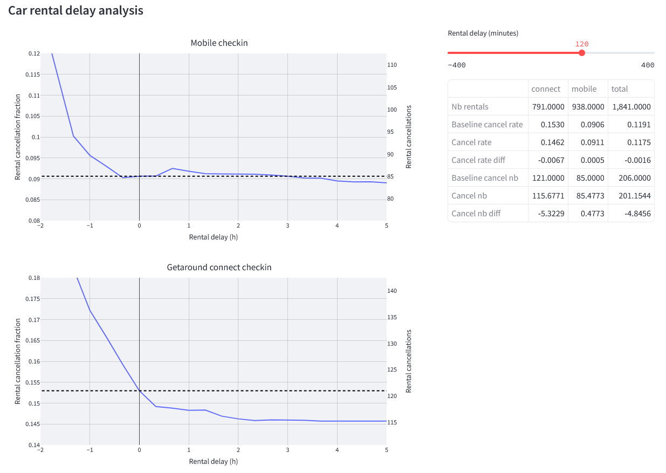
Dashboard : rental delay analysis
Visualize the effect of a rental delay
Cancellation probability
Both checkin methods
Summary table
Rental delay slider
Quantitative insights

Slide 8

Thanks!

Slide 9

Title or Graph
Legend

Slide 10

“Citation ou mise en exergue”
Nom de l’auteur / légende

Slide 11
Text
bullet point
bullet point
bullet point

Slide 12
Context
Tasks
Create an application for Kayak customers
Get geographic coordinates of locations
Get weather forecast for each location
Provides information about
Weather forecast
Get information about hotels in each location
Hotels in the area
Selection of 35 top locations to visit
Archive the data in a data lake
Mont St Michel, St Malo, Bayeaux, Le Havre, Rouen, ...
Store the data in a database

